Slide 1
EXPLORING CLOUD INFRASTRUCTURE
Module-3

Slide 2
EXPLORING CLOUD INFRASTRUCTURE
1. Barrie Sosinsky, “Cloud Computing Bible”, Wiley-India, 2010 . (Text Book 1 Chapter 11 & 12)
2. Reference : White paper
Administrating the Clouds ,Management responsibilities ,Lifecycle management , Cloud Management Products, Emerging Cloud Management Standards, Securing the Cloud, Securing Data , Establishing Identity and Presence
3. Tim Mather, Subra Kumarswamy, “Cloud Security and Privacy, 2009
Chapter 5: Identity and Access Management
Notes:
A white paper is an in-depth report or guide about a specific topic and the problems that surround it

Slide 3
Administrating the Clouds
The explosive growth in cloud computing services has led many vendors to rename their products and reposition them to get in on the gold rush in the clouds.
What was once a network management product is now a cloud management product

Slide 4
Administrating the Clouds
Fundamental features are offered by traditional network management systems:
Administration of resources
Configuring resources
Enforcing security
Monitoring operations
Optimizing performance
Policy management
Performing maintenance
Provisioning of resources
Notes:
administration of Resources: Managing user accounts, permissions, and network inventory to ensure resources are available to designated users.
Configuring Resources: Initial setup and ongoing management of hardware and software settings, such as IP addresses, routing, and firmware.
Enforcing Security: Protecting the network from unauthorized access and cyber threats through policy enforcement, firewall management, and access controls.
Monitoring Operations: Real-time tracking of network health and device status to detect faults, errors, or service disruptions.
Optimizing Performance: Gathering and analyzing metrics (like bandwidth usage, latency, and packet loss) to ensure acceptable service levels.
Policy Management: Establishing and applying rules for network behavior, security protocols, and resource allocation across the infrastructure.
Performing Maintenance: Executing routine updates, software patches, and troubleshooting to ensure long-term stability and reliability.
Provisioning of Resources: Configuring the network to support new services, such as setting up voice features or accommodating additional users.

Slide 5
Describing virtualization
Network management systems are often described in terms of the acronym FCAPS, which stands for these features:
F ault
C onfiguration
A ccounting
P erformance
S ecurity
Notes:
FCAPS is an ISO Telecommunications Management Network framework defining five critical functional areas for comprehensive network management: Fault, Configuration, Accounting, Performance, and Security
Fault management: Identify, log, report, and fix faults to minimize downtime
Configuration management: Record all network components and centrally control network configuration
Accounting management: Track network usage to bill customers and ensure revenue
Performance management: Collect and analyze performance data to monitor network stability
Security management: Allocate access and usage rights, and authenticate users to protect network integrity

Slide 6
Describing virtualization
Benefits of FCAPS
The FCAPS framework helps network teams address every critical aspect of network operations.
It provides a structured approach to maintain and optimize networks.

Slide 7
Administrating the Clouds
Most network management packages have one or more of these characteristics; no single package provides all five elements of FCAPS.
To get the complete set of all five of these management areas from a single vendor, you would need to adopt a network management framework.
These large network management frameworks were industry leaders several years back: BMC PATROL, CA Unicenter, IBM Tivoli, HP OpenView, and Microsoft System Center. `

Slide 8
Administrating the Clouds
Enterprises and Cloud service providers can use Enterprise Manager to build and operate their Cloud services.
Enterprises must support hundreds or even thousands of applications to meet growing business demands. and storage.
Clouds enable customers to consolidate servers, storage, and database workloads onto a shared hardware and software infrastructure.

Slide 9
Administrating the Clouds
Enterprise Manager offers the following benefits:
Increasing Quality of Service
Enabling Faster Deployment
Providing Resource Elasticity
Rapid Provisioning

Slide 10
Administrating the Clouds
Increasing Quality of Service
IT organizations are not only trying to drive down costs, they are also looking at solutions that will simultaneously improve quality of service in terms of performance, availability and security
Enabling Faster Deployment
Building the Cloud infrastructure using standard building block components (for example, servers, CPUs, storage, and network), configurations, and tools, enables a streamlined, automated, and simplified deployment process.
Providing Resource Elasticity
The ability to grow and shrink the capacity of a given database, both in terms of storage size and compute power, allows applications the flexibility to meet the dynamic nature of business workloads.
Rapid Provisioning
Databases in a Cloud can be rapidly provisioned, often by way of a self-service infrastructure, providing agility in application deployment.
This reduces overall time in deploying production applications, development platforms, or creating test bed configurations.

Slide 11
Administrating the Clouds
Managing the Cloud Management Lifecycle With Enterprise Manager:
Planning
Setting Up the Cloud
Building the Cloud
Testing and Deploying a Service
Monitoring and Managing the Cloud
Metering, Charging, and Optimization

Slide 12
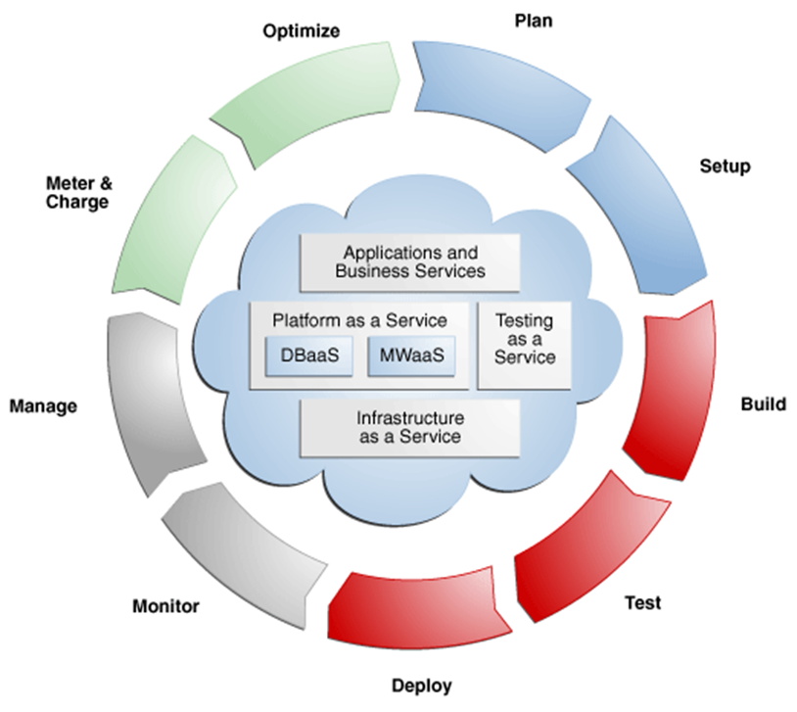
Managing the Cloud Management Lifecycle

Slide 13
Managing the Cloud Management lifecycle
1. Planning
Using Enterprise Manager, you can transform existing data centers into a Cloud environment.
Before setting up a Cloud, you should map out your infrastructure requirements, such as the physical and virtual networks, storage arrays, applications and so on.
The Enterprise Manager Consolidation Planner is a powerful tool that helps administrators plan the Cloud architecture.
It allows you to identify source and destination targets and applicable technical and functional constraints such as where the application can reside, and so on.
You can generate consolidation advisories that may include plans to move from Physical to Virtual (P2V), Physical to Physical (P2P).

Slide 14
2. Setting Up the Cloud
Enterprise Manager can be used to model Infrastructure-as-a-Service (IaaS), Software-as-a-Service (SaaS), Platform-as-a-Service (PaaS) clouds, DataBase as a Service(DaaS), Middleware as a service(MaaS) .
It is important to select the appropriate Cloud Service Model that suits the needs of your users and organization.
To facilitate Cloud setup, Enterprise Manager offers capabilities for both physical and virtual infrastructure.
Enterprise Manager leverages its core automation framework for physical infrastructure of deployment procedures, job system, and the enterprise software library.
It offers out of the box deployment procedures that can be used for provisioning the pre-requisite software for both databases and middleware.
The same automation framework is also used to interact with third party storage systems for the purposes of data cloning and storage management.

Slide 15
Setting Up the Cloud
Enterprise Manager can be used to model Infrastructure-as-a-Service (IaaS), Database-as-a-Service (DBaaS), and Middleware-as-a-Service (MWaaS) clouds.
It is important to select the appropriate Cloud Service Model that suits the needs of your users and organization.
To facilitate Cloud setup, Enterprise Manager offers capabilities for both physical and virtual infrastructure.
Enterprise Manager leverages its core automation framework for physical infrastructure of deployment procedures, job system, and the enterprise software library.
It offers out-of-the-box deployment procedures for provisioning the prerequisite software for both databases and middleware. The same automation framework is also used to interact with third party storage systems for the purposes of data cloning and storage management

Slide 16
Setting Up the Cloud
For example for virtual infrastructure, it offers bare metal provisioning of suitable hypervisor and setting up server and storage pools.
Once completed, you can group all of these into zones based on functional or QoS characteristics.
Enterprise Manager leverages the Virtualization Storage Connect technology

Slide 17
Setting Up the Cloud
Enterprise Manager uses components called assemblies.
These assemblies help package a multi-tier platform into a single metadata that the Enterprise Manager Cloud service can deploy.
An assembly is essentially a complete multi-tier application stack - including database, application server and other middleware components - packaged as a single downloadable entity.
When an assembly is deployed, the result is the creation of a set of related virtual machines representing every tier of the application stack.
This assembly can then be published to the centralized Software Library in Enterprise Manager, and be made available to developers as a Cloud service – an entire application development stack, that can be provisioned quickly.

Slide 18
Building the Cloud
Enterprise Manager allows entire applications or components to be packaged and published to the Cloud as a service.
This expedites application development and provisioning processes within an organization.
Developers can publish utility components and applications in the form of assemblies and service templates for reuse within their groups.
Similarly, allowing applications to be available as assemblies allows testing teams, business analysts/ production teams to deploy pre-built applications in a few clicks.

Slide 19
Testing and Deploying a Service
After an application has been built, it needs to be tested
Enterprise Manager provides a testing portfolio that allows users to test both application changes and changes to the database.
The testing solution provides the ability to capture a production load and replay in a test environment so that the results are predictable.
Enterprise Manager provides a self-service application that lets end-users deploy a service. This self-service application can also be customized

Slide 20
Monitoring and Managing the Cloud
Enterprise Manger offers a number of inherent monitoring and management features that collectively comprise a full Cloud management system.
Enterprise Manager's built-in Incident Management system allows you to monitor the Cloud for complex operational issues that may affect performance.
You can review, suppress, escalate and remediate events that occur as needed, and even integrate incident escalation with existing support ticketing system
Contractual Service Level Agreements (SLAs) can be defined to govern the contract between the application owner and the provider of the Cloud

Slide 21
Metering, Charging, and Optimization
The Metering and Chargeback features in Enterprise Manager enable enterprises to account for actual usage versus representative usage.
Enterprise Manager provides administrators and application users with features that help rediscover assets, re-evaluate the performance, rebalance the Cloud, and fine-tune the provisioning process.
Chargeback supports basic metrics like CPU, memory, and storage usage.
It also offers pricing models based on application usage, database usage, and Middleware-level metrics.
Cloud Management also entails an ongoing optimization of resources as well as processes to make sure that the service levels are persistent

Slide 22
Emerging Cloud Management Standards
As it stands now, different cloud service providers use different technologies for creating and managing cloud resources.
As the area matures, cloud providers are going to be under considerable pressure from large cloud users like the federal government to conform to standards and make their systems interoperable with one another.
To this end, several large industry players such as VMware, IBM, Microsoft, Citrix, and HP have gotten together to create standards that can be used to promote cloud interoperability.

Slide 23
DMTF cloud management standard
The Distributed Management Task Force (DMTF; see http://www.dmtf.org/) is an industry organization that develops industry system management standards for platform interoperability.
Its membership is a “who’s who” in computing, and since its founding in 1992, the group has been responsible for several industry standards, most notably the Common Information Model (CIM).
The DMTF organizes itself into a set of working groups that are tasked with specifying standards for different areas of technology

Slide 24
DMTF cloud management standard
A recent standard called the Virtualization Management Initiative (VMAN) was developed to extend CIM to virtual computer system management.
VMAN has resulted in the creation of the Open Virtualization Format (OVF), which describes a standard method for creating, packaging, and provisioning virtual appliances.
OVF is essentially a container and an open file format, and both hypervisor- and processor-architecture-agnostic.
Since OVF was announced in 2009, vendors such as VirtualBox, AbiCloud, IBM, Red Hat, and VMWare have announced or introduced products that use OVF

Slide 25
DMTF cloud management standard
DMTF has multiple standards and working groups addressing cloud management, and the Cloud Management Initiative brings this work together for an integrated approach.
Focused on achieving interoperable cloud infrastructure management between cloud service providers and their consumers and developers, the Cloud Management Initiative also promotes adoption of these standards by the industry.
The Cloud Management Initiative produced standards and whitepapers in the following areas:

Slide 26
DMTF cloud management standard
*The Cloud Management Initiative produced standards and whitepapers in the following areas:
Cloud Infrastructure Management Interface (CIMI) - describes the model and protocol for management interactions between a cloud Infrastructure as a Service (IaaS) provider and the consumers of an IaaS service. The basic resources of IaaS (machines, storage, and networks) are modeled to provide consumer management access to an implementation of IaaS and facilitate portability between cloud implementations that support the specification.
b) Open Virtualization Format (OVF) – a portable metadata format for the distribution of virtual systems onto and between virtualization platforms.
Notes:
OVF provides the industry with a standard packaging format for software solutions based on virtual systems. OVF has been adopted and published by the International Organization for Standardization (ISO) as ISO 17203.

Slide 27
DMTF cloud management standard
c) Cloud Audit Data Federation (CADF) Data Format and Interface Definitions - is an open standard providing a common model for logging, formatting, and exchanging audit events across diverse cloud environments. It ensures security, compliance, and interoperability in hybrid/multi-cloud setups by normalizing audit data from different providers.
d) Software Identification and Entitlement Usage Metrics Whitepaper– a document which describes information useful in identifying licensed software products, and to trace and gather the use of the software and other entitlement usage metrics across the span of deployments.

Slide 28
Understanding Cloud Security
Security in cloud computing is a major concern.
Data in cloud should be stored in encrypted form.
To restrict client from accessing the shared data directly, proxy and brokerage services should be employed.
Logging, auditing, and regulatory compliance are all features that require planning in cloud computing system

Slide 29
Understanding Cloud Security
Before deploying a particular resource to the cloud, one should analyze several aspects of the resource such as:
Select resource that needs to move to the cloud and analyze its sensitivity to risk.
Consider cloud service models such as IaaS, PaaS, and SaaS. These models require customer to be responsible for security at different levels of service.
Consider the cloud type to be used such as public, private, community or hybrid.
Understand the cloud service provider's system about data storage and its transfer into and out of the cloud.

Slide 30
Security Boundaries
A particular service model defines the boundary between the responsibilities of service provider and customer.
The most commonly used model based on U.S. National Institute of Standards and Technology (NIST); separates deployment models from service models and assigns those models a set of service attributes.
Deployment models are cloud types: community, hybrid, private, and public clouds. Service models follow the SPI (cloud service delivery) Model for three forms of service delivery: Software, Platform, and Infrastructure as a Service
Cloud Security Alliance (CSA) stack model defines the boundaries between each service model and shows how different functional units relate to each other. :

Slide 31
Security Boundaries
One key difference between the NIST model and the CSA is that the CSA considers multi-tenancy to be an essential element in cloud computing.
Multi-tenancy adds a number of additional security concerns to cloud computing that need to be accounted for.
In multi-tenancy, different customers must be isolated, their data segmented, and their service accounted for.
To provide these features, the cloud service provider must provide a policy-based environment that is capable of supporting different levels and quality of service, usually using different pricing models.
Multi-tenancy expresses itself in different ways in the different cloud deployment models and imposes security concerns in different places
The following diagram shows the CSA stack model:

Slide 32
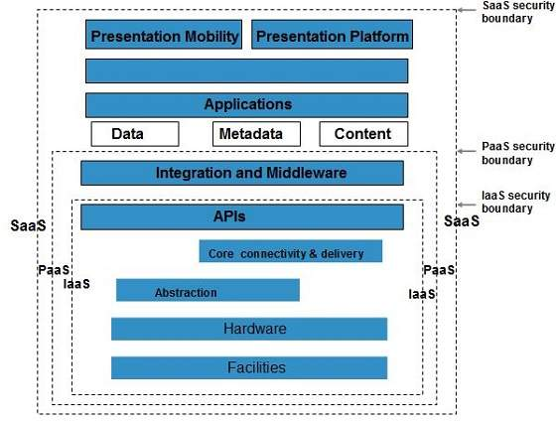
Security Boundaries
The following diagram shows the CSA stack model:

Slide 33
Key Points to CSA Model
IaaS is the most basic level of service with PaaS and SaaS next two above levels of services.
Moving upwards, each of the service inherits capabilities and security concerns of the model beneath.
IaaS provides the infrastructure, PaaS provides platform development environment, and SaaS provides operating environment.
IaaS has the least level of integrated functionalities and integrated security while SaaS has the most.
This model describes the security boundaries at which cloud service provider's responsibilities end and the customer's responsibilities begin.
Any security mechanism below the security boundary must be built into the system and should be maintained by the customer.

Slide 34
In the NIST model, it is accurate that virtualization and multi-tenancy are not explicitly required for a system to be classified as a cloud, as the definition focuses on characteristics like resource pooling, rapid elasticity, and on-demand self-service.
However, your statement regarding the compromise of a hypervisor highlights a major security challenge:
• Hypervisor Vulnerabilities: If a hypervisor is compromised, all VMs running on that physical host are at risk of unauthorized access or control, as they share the same underlying hardware. (Virtualization is not mandatory)
• Security Complexity: Because the NIST model focuses on the functionality (e.g., resource pooling) rather than specific technologies (e.g., VMs), organizations must implement security mechanisms to address the risks associated with the chosen

Slide 35
Understanding Data Security
Securing data sent to, received from, and stored in the cloud is the single largest security concern that most organizations should have with cloud computing.
Since all the data is transferred using Internet, data security is of major concern in the cloud.
Here are key mechanisms for protecting data:
Access Control
Auditing
Authentication
Authorization

Slide 36
Understanding Data Security
Authentication
How do you map the correct users to gain access to the correct content, at the correct times?
Authentication takes place whenever a user attempts to access the organization’s network or assets.
Verified credentials serve as a password that allows users to access data, systems, applications, and resources
Authorization
Authorization is the number of functions the user can perform or information the user has access to.
It is where the access control system comes into play and serves its main purpose

Slide 37
Understanding Data Security
Data access control
Data access control is a technique used to regulate employees access to files in an organization.
Access Control in cloud security is a system with which a company can regulate and monitor permissions, or access to their business data by formulating various policies suited chosen by the company.
Key points about role-based attribute-based access control:
1. Roles:
Users are assigned specific roles within an organization, which define a set of base permissions based on their job responsibilities.
2. Attributes:
Beyond just the role, additional attributes about the user, the resource they are trying to access, and the environment (like location or time) are considered to further refine access decisions.

Slide 38
Understanding Data Security
Auditing
Auditing security configurations helps weed out redundancies within the IAM system, such as IAM users, roles, and policies that are not required, and make sure that all users are authorized and authenticated.
It also helps secure the system by regularly monitoring who has access to critical enterprise assets.
Audits ensure that compliance requirements are met, incidents are responded to and taken care of within a defined period of time, procedures are streamlined, responsibilities are segregated, and transparency and documentation are maintained.

Slide 39
Understanding Data Security
Authorization is the number of functions the user can perform or information the user has access to. It is where the access control system comes into play and serves its main purpose
Network security auditing is the process of independently examining information relating to your organization's IT controls, security systems, and risk mitigation policies and procedures.
3. Data access control is a technique used to regulate employees access to files in an organization. Access Control in cloud security is a system with which a company can regulate and monitor permissions, or access to their business data by formulating various policies suited chosen by the company.
Key points about role-based attribute-based access control:
Roles:
Users are assigned specific roles within an organization, which define a set of base permissions based on their job responsibilities.
Attributes:
Beyond just the role, additional attributes about the user, the resource they are trying to access, and the environment (like location or time) are considered to further refine access decisions.
Notes:
1.The process of verifying the identity of a user, process, or device, often as a prerequisite to allowing access to resources in an information system.
An IT security audit is an assessment of an information system's security architecture and processes, as well as all related policies and procedures for managing data in a secure manner.
A cloud audit is a test of a cloud environment, typically conducted by an independent third-party. During an audit, the auditor gathers evidence via physical inspection, inquiry, observation, re-performance, or analytics.
4. Authorization is the number of functions the user can perform or information the user has access to. It is where the access control system comes into play and serves its main purpose.
Access control is a data security process that enables organizations to manage who is authorized to access corporate data and resources. Secure access control uses policies that verify users are who they claim to be and ensures appropriate control access levels are granted to users.
3. Data access control is a technique used to regulate employees access to files in an organization. Access Control in cloud security is a system with which a company can regulate and monitor permissions, or access to their business data by formulating various policies suited chosen by the company.
4. Authorization in system security is the process of giving the user permission to access a specific resource or function.

Slide 40
Brokered Cloud Storage Access is an approach for isolating storage in the cloud:
The problem with the data you store in the cloud is that it can be located anywhere in the cloud service provider’s system: in another data center, another state or province, and in many cases even in another country.
With other system architectures, such as client/server, you could count on a firewall as your network’s security perimeter; cloud computing has no physical system that serves this purpose. Therefore, to protect your cloud storage assets, you want to find a way to isolate data from direct client access.
In this approach, two services are created:
A broker with full access to storage but no access to client.
A proxy with no access to storage but access to both client and broker.

Slide 41
Working Of Brokered Cloud Storage Access System
When the client issues request to access data
The client data request goes to the external service interface of proxy.
The proxy forwards the request to the broker.
The broker requests the data from cloud storage system.
The cloud storage system returns the data to the broker.
The broker returns the data to proxy.
Finally the proxy sends the data to the client.

Slide 42
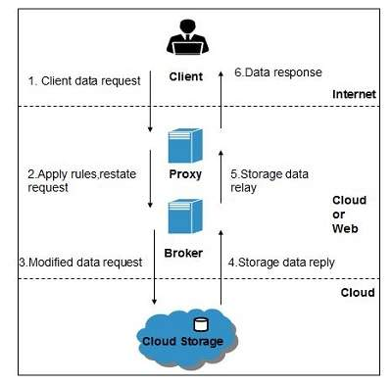
Working Of Brokered Cloud Storage Access System
All of the above steps are shown in the following diagram:
Figure 12.4

Slide 43
Working Of Brokered Cloud Storage Access System
The use of multiple encryption keys can further separate the proxy service from the storage account.
If you use two separate keys to create two different data zones—one for the untrusted communication between the proxy and broker services, and another a trusted zone between the broker and the cloud storage—you create a situation where there is further separation between the different service roles
Even if the proxy service is compromised, that service does not have access to the trusted key necessary to access the cloud storage account.
In the multi-key solution, shown in Figure 12.5, you have not only eliminated all internal service endpoints, but you also have eliminated the need to have the proxy service run at a reduced trust level

Slide 44
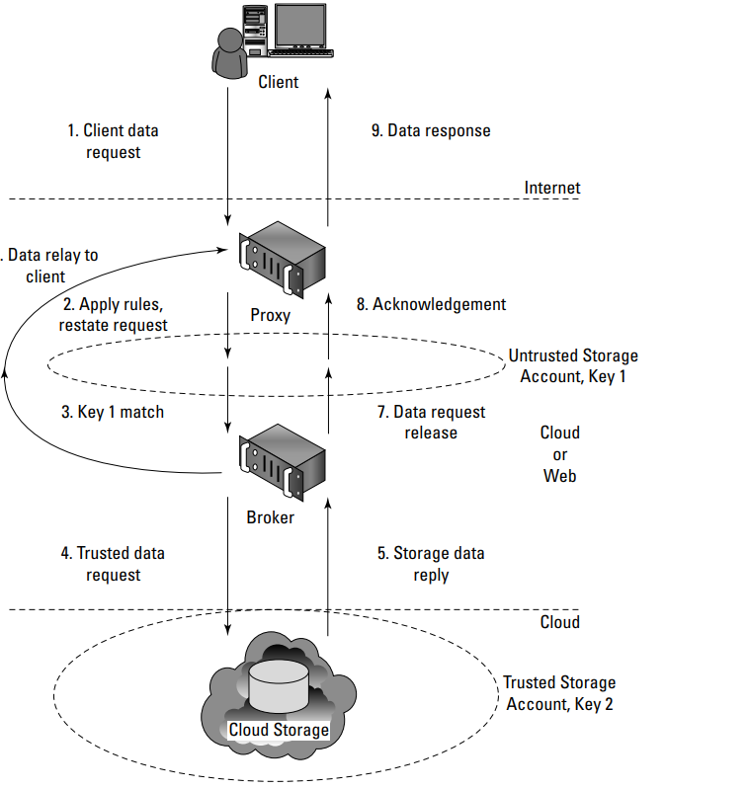
Encryption
The creation of storage zones with associated encryption keys can further protect cloud storage from unauthorized access
Figure 12.5

Slide 45
Encryption
In the multi-key solution, shown in Figure 12.5, you have not only eliminated all internal service endpoints, but you also have eliminated the need to have the proxy service run at a reduced trust level

Slide 46
Encryption
Most cloud service providers store data in an encrypted form. While encryption is important and effective, it does present its own set of problems.
When there is a problem with encrypted data, the result is that the data may not be recoverable.
It is worth considering what type of encryption the cloud provider uses and checking that the system has been planned and tested by security experts

Slide 47
Encryption
Strong encryption technology is a core technology for protecting data in transit to and from the cloud as well as data stored in the cloud
The goal of encrypted cloud storage is to create a virtual private storage system that maintains confidentiality and data integrity while maintaining the benefits of cloud storage: ubiquitous, reliable, shared data storage.
Encryption should separate stored data (data at rest) from data in transit

Slide 48
Encryption
Depending upon the particular cloud provider, you can create multiple accounts with different keys
Microsoft allows up to five security accounts per client, and you can use these different accounts to create different zones.
On Amazon Web Service, you can create multiple keys and rotate those keys during different sessions.

Slide 49
Encryption
Strong encryption technology is a core technology for protecting data in transit to and from the cloud as well as data stored in the cloud
The goal of encrypted cloud storage is to create a virtual private storage system that maintains confidentiality and data integrity while maintaining the benefits of cloud storage: ubiquitous, reliable, shared data storage.
Encryption should separate stored data (data at rest) from data in transit
Depending upon the particular cloud provider, you can create multiple accounts with different keys as you saw in the example with Windows Azure Platform in the previous section.
Microsoft allows up to five security accounts per client, and you can use these different accounts to create different zones.
On Amazon Web Service, you can create multiple keys and rotate those keys during different sessions.

Slide 50
Auditing and Compliance
Logging is the recording of events into a repository;
Auditing is the ability to monitor the events to understand performance.
Logging and auditing is an important functions because it is not only necessary for evaluation performance, but are also used to investigate security and when illegal activity has been perpetrated.
Logs should record system, application, and security events, at the very minimum.
Logging and auditing are unfortunately one of the weaker aspects of early cloud computing service offerings

Slide 51
Auditing and Compliance
Cloud service providers often have proprietary log formats that you need to be aware of.
Whatever monitoring and analysis tools you use need to be aware of these logs and able to work with them.
Often, providers offer monitoring tools of their own, many in the form of a dashboard with the potential to customize the information you see through either the interface or programmatically using the vendor’s API.

Slide 52
Auditing and Compliance
Because cloud services are both multitenant and multisite operations, the logging activity and data for different clients may not only be co-located, they may also be moving across a landscape of different hosts and sites.
You can’t simply expect that an investigation will be provided with the necessary information at the time of discovery unless it is part of your Service Level Agreement.
Even an SLA with the appropriate obligations contained in it may not be enough to guarantee you will get the information you need when the time comes.
It is wise to determine whether the cloud service provider has been able to successfully support investigations in the past

Slide 53
Auditing and Compliance
A regulator or auditor isn’t likely to be familiar with the nature of running applications and storing data in the cloud.
Even so, laws are written to ensure compliance, and the client is held responsible for compliance under the laws of the governing bodies that apply to the location where the processing or storage takes place

Slide 54
Auditing and Compliance
In cloud security auditing and logging, an Auditor is a third-party entity responsible for reviewing a cloud service provider's (CSP) security practices and controls to verify compliance with regulations and standards,
While the Regulator sets the compliance requirements,
The cloud service provider (CSP) is responsible for securing the underlying cloud infrastructure,
The cloud Consumer is responsible for securing their data and applications within the cloud environment, including proper configuration and access controls, as defined by the shared responsibility model.

Slide 55
Auditing and Compliance
Breakdown of responsibilities:
Auditor:
Conducts independent assessments of a cloud environment.
Verifies that the CSP adheres to relevant security standards and regulations.
Reviews security controls, access management, data encryption, incident response plans, and more.
Provides reports detailing findings and recommendations for improvement.

Slide 56
Auditing and Compliance
Regulator:
Sets industry-specific compliance standards and regulations.
Defines data privacy and security requirements that cloud providers must meet.
May conduct oversight to ensure compliance with regulations.
Cloud Service Provider (CSP):
Securing the underlying cloud infrastructure, including hardware, network, and data centers.
Implementing robust security controls to protect customer data.
Providing access to audit logs and security features for customers to monitor their usage.

Slide 57
Auditing and Compliance
Cloud Consumer:
Securing their data and applications within the cloud environment.
Properly configuring cloud services and managing user access controls.
Implementing appropriate encryption mechanisms for sensitive data.
Staying informed about CSP security practices and updates.

Slide 58
Auditing and Compliance
Key points to remember:
The shared responsibility model means both the CSP and the cloud consumer have roles to play in maintaining cloud security.
Auditors typically work with both the CSP and the cloud consumer to assess overall security posture.
Regulatory compliance is crucial, and both the CSP and the consumer must adhere to relevant standards.

Slide 59
Auditing and Compliance
Understand the following:
Which regulations apply to your use of a particular cloud computing service
Which regulations apply to the cloud service provider and where the demarcation line falls for responsibilities
How your cloud service provider will support your need for information associated with regulation
How to work with the regulator to provide the information necessary regardless of who had the responsibility to collect the data

Slide 60
Auditing and Compliance
In the case of a cloud service provider who shows reluctance to or limits the scrutiny of its operations, it is probably wise to use the service in ways that limit your exposure to risk.
For example, although encrypting stored data is always a good policy, you also might want to consider not storing any sensitive information on that provider’s system.

Slide 61
Auditing and Compliance
As it stands now, clients must guarantee their own regulatory compliance, even when their data is in the care of the service provider.
You must ensure that your data is secure and that its integrity has not been compromised.
When multiple regulatory entities are involved, as there surely are
between site locations and different countries, then that burden to satisfy the laws of those governments is also your responsibility.

Slide 62
Establishing Identity: IAM
What is an identity?
What are the standard ways to establish an identity?

Slide 63
Establishing Identity
Federated identity management is an arrangement that can be made among multiple enterprises that lets subscribers use the same identification data to obtain access to services of all enterprises in the group
Within the enterprise, an identity management system comprises a system of directories and access control based on policies.
It includes the maintenance of the system (adds, changes, deletes) and generally offers authentication, authorization, SSO and auditing (AAAs).
When federating identities to the cloud, organizations may need to manage the identity life cycle using their IAM system and processes

Slide 64
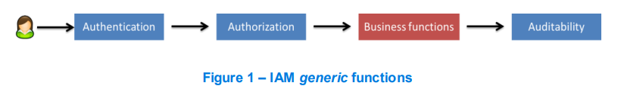
IAM system
Identity Management is the combination of business process and technology used to manage data on IT systems and applications about users.
Managed data includes user objects, identity attributes, security entitlements and authentication factors
Figure 1 shows, at blue, the three main functionalities of an IAM system.

Slide 65
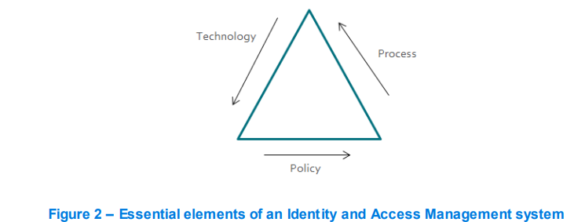
IAM system
IAM is not just about technology, it comprises three essential elements: policies, processes and technologies.

Slide 66
Standardization and Initiative Groups
The Identity Management area, and all the related domains, has been the ground for several initiatives.
Some of the initiatives are drive by more traditional organization groups such as
OAuth protocol(Open Authorization)
OpenID is a widely used, secure authentication protocol built on OAuth 2.0 that allows users to sign into multiple websites

Slide 67
Standardization and Initiative Groups
OAuth (Open Authorization)
OAuth is an IETF standard for authorization.
OAuth provides a method for clients to access server resources on behalf of a resource owner (such as a different client or an end-user).
It also provides a process for end -users to authorize third-party access to their server resources without sharing their credentials (typically, a username and password pair), using user-agent redirections.
Two different versions (1.0a and 2.0) of OAuth are nowdays disseminated and supported by most of the Web 2.0 providers (i.e.Facebook, Google etc)
Notes:
IETF: Internet Engineering Task Force: The IETF is working on standards for automated network management which, as the name implies, aims to improve and make more efficient management of networks

Slide 68
Standardization and Initiative Groups
OAuth
The protocol specifies four entities:
Authorization Server – The server that issues and validates the tokens. The tokens are the information that correlates the user, the requester, and the resource scope authorized by the user.
Resource Owner – The resource owner is the user that owns the resource protected by the resource server and that wants to be accessed by the Client/Application.
Resource Server – The entity that stores the resource and provides it to the Client/Application after token validation in the Authorization Server.
Client/Application – The entity that wants to access the resource owned by the user (resource owner).

Slide 69
Standardization and Initiative Groups
OAuth 2.0
OAuth 2.0 logoOAuth 2.0 is the industry-standard protocol for authorization.
OAuth 2.0 focuses on client developer simplicity while providing specific authorization flows for web applications, desktop applications, mobile phones, and living room devices.
This specification and its extensions are being developed within the IETF OAuth Working Group.

Slide 70
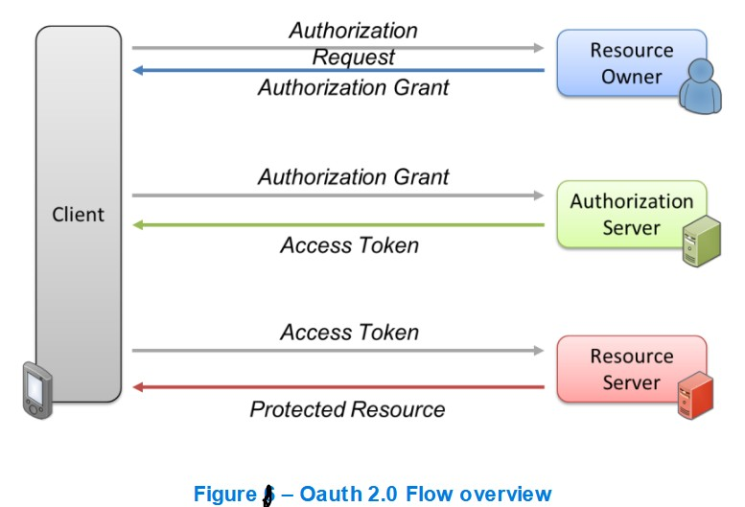
Standardization and Initiative Groups
OAuth 2.0
Resource Owner: Represents the user who owns the data (like their photos on a social media platform). Provides credentials to the authorization server when asked to grant access to an application.
Authorization Server: Validates the resource owner's identity and credentials when they are presented. Determines if the resource owner has given consent to an application to access their data.
The resource server: is the server that stores and manages the protected data and validates access tokens to grant access to the requested resources on behalf of the resource owner.

Slide 71
Standardization and Initiative Groups
OAuth 2.0
The Client/Application has to be registered in the Authorization Server.
The result of this enrolment is that the Client gets a unique API Key and API Secret, used to set-up a secure (i.e. HTTPS) transport channel, in order to guarantee that the application is authenticated, is identified and has authorization to access the authorization end points
The previous figure presents the OAuth 2.0 flow

Slide 72
Standardization and Initiative Groups
OASIS (Organization for the Advancement of Structured Information Standards) promotes industry consensus and produces worldwide standards for security, Cloud computing, SOA, etc
OASIS open standards offer the potential to lower cost, stimulate innovation, grow global markets, and protect the right of free choice of technology.
OASIS defines a set of standards related with Identity Management topics.
Among them are the following one:
SAML (Secure Assertion Markup Language) protocol and bindings
XACML (eXtensible Access Control Markup Language)

Slide 73
SAML
Security Assertion Markup Language (SAML) [6] is an XML standard that allows secure web domains to exchange user authentication and authorization data.
Using SAML, an online service provider can contact a separate online identity provider to authenticate users who are trying to access secure content.

Slide 74
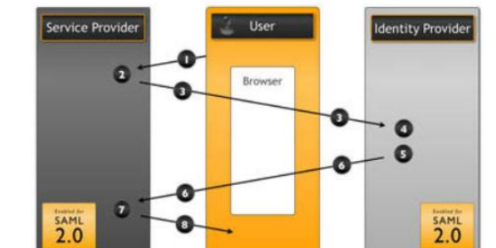
SAML
A brief overview of the SAML process is presented next and illustrated in Figure 3.
Figure 3 – SAML process

Slide 75
Identity Provider (IdP):
Function: Authenticates the user and asserts their identity to the service provider.
Responsibility: Stores user credentials, handles logins, and manages password policies.
Examples: Azure Active Directory, Ping Identity.
Service Provider (SP):
Function: Trusts the IdP to authenticate users and grants access to protected resources based on the assertion.
Responsibility: Provides the actual service or application the user wants to access.
Examples: Salesforce, Gmail, AWS

Slide 76
User requests a service from the Service Provider;
Service Provider verifies if the user has a SAML token;
User gets redirected to the Identity Provider (authentication delegation) ;
Identity Provider authenticates the user;
Identity Provider creates a SAML token;
User gets redirected to the Service Provider, with the SAML token;
Service Provider verifies the SAML token;
Service Provider gives the requested information to the user.

Slide 77
XACML
XACML is an OASIS-ratified, general-purpose, XML-based access control language for policy management and access decisions.
It provides an XML schema for a general policy language which is used to protect any kind of resource and make access decisions over these resources.
The XACML standard not only gives the model of the policy language but also proposes a processing environment model to manage the policies and to conclude the access decision
Notes:
.

Slide 78
XACML
Most applications (web or otherwise) have a built-in authorization module that grants or denies access to certain application functions or resources based on entitlements assigned to the user.
Hence, the goal of XACML is to provide a standardized language, a method of access control, and policy enforcement across all applications that implement a common authorization standard.
These authorization decisions are based on various authorization policies and rules centered on the user role and job function.

Slide 79
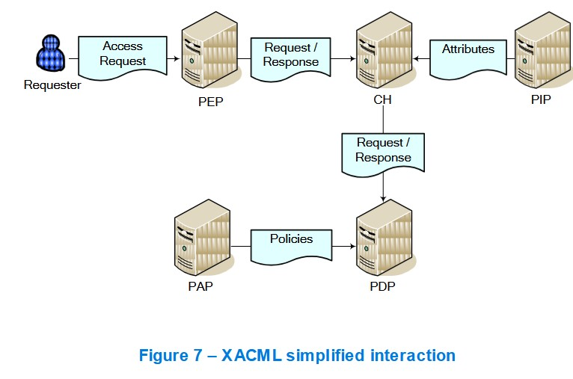
XACML
The XACML context also specifies the request/response protocol that the application environment can use to communicate with the decision point.
The response to an access request is also specified using XML

Slide 80
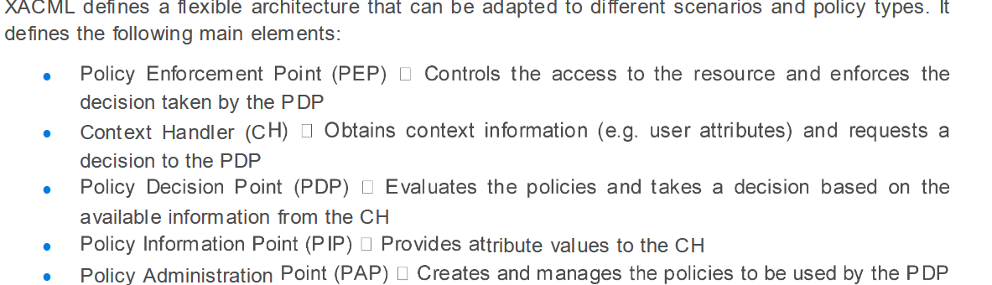
XACML

Slide 81
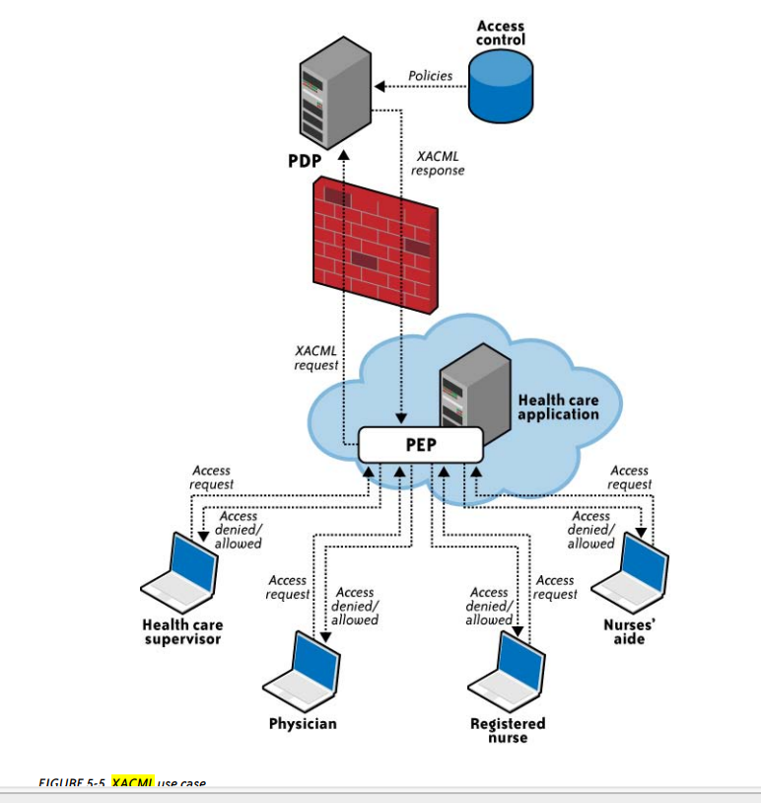
Figure 5-5 illustrates the interaction among various health care participants with unique roles (authorization privileges) accessing sensitive patient records stored in a health care application.
Notes:
The health care application manages various hospital associates (the physician, registered nurse, nurses’ aide, and health care supervisor) accessing various elements of the patient record. This application relies on the policy enforcement point (PEP) and forwards the request to the PEP.
The PEP is actually the interface of the application environment. It receives the access requests and evaluates them with the help of the policy decision point (PDP). It then permits or denies access to the resource (the health care record).
The PDP should be located in a trusted network with strong access control policies, e.g., in a corporate trusted network protected by a corporate firewall. 4. After evaluation, the PDP sends the XACML response to the PEP.

Slide 82
The health care application manages various hospital associates (the physician, registered nurse, nurses’ aide, and health care supervisor) accessing various elements of the patient record.
This application relies on the policy enforcement point (PEP) and forwards the request to the PEP.
The PEP is actually the interface of the application environment. It receives the access requests and evaluates them with the help of the policy decision point (PDP). It then permits or denies access to the resource (the health care record).
The PDP should be located in a trusted network with strong access control policies, e.g., in a corporate trusted network protected by a corporate firewall.
After evaluation, the PDP sends the XACML response to the PEP.

Slide 83
The Workflow and Decision
Dr. Smith requests access (via PEP).
PEP asks PDP: "Can Dr. Smith read this?"
PDP retrieves policies from PAP.
PDP asks PIP for Dr. Smith’s department and patient Alice’s assigned department.
PIP returns: Dr. Smith = Cardiology; Alice = Cardiology.
PDP checks policy: "Physician can read if Depts match."

Slide 84
Open ID for Authentication
OpenID Connect enables an Internet identity ecosystem through easy integration and support, security and privacy-preserving configuration, interoperability, wide support of clients and devices, and enabling any entity to be an OpenID Provider (OP).

Slide 85
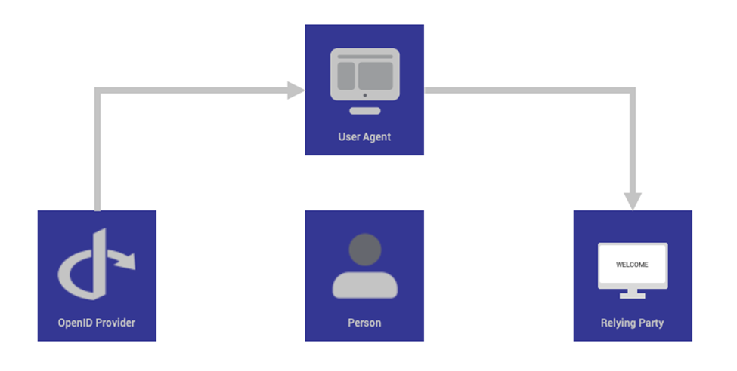
Open ID for Authentication
Notes:
User (End-User): The individual who is attempting to access a service or application. The user has an account with the OpenID Provider and provides consent for their identity information to be shared with the Relying Party
User Agent: This is the mechanism the user employs to interact with the applications, most commonly a web browser or a mobile application.
Relying Party (RP): The application or website that needs to verify the user's identity to grant access to its resources or services
OpenID Provider (OP): The entity that performs the actual user authentication and then issues identity and security tokens to the RP.
The OP is an OAuth 2.0 Authorization Server capable of authenticating the user (e.g., Google, Microsoft Entra ID).

Slide 86
How does Open ID work?
The OpenID Connect protocol, in abstract, follows these steps:
1. End user navigates to a website or web application via a browser.
2. End user clicks sign-in and types their username and password.
3. The RP (Client) sends a request to the OpenID Provider (OP).
4. The OP authenticates the User and obtains authorization.
5. The OP responds with an Identity Token and usually an Access Token.
6. The RP can send a request to the User device with the Access Token.
7. The UserInfo Endpoint returns Claims about the End-User.

Slide 87
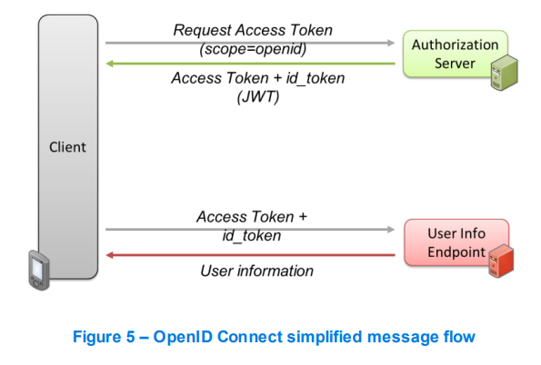
OpenID
OpenID Connect 1.0 is a simple identity layer on top of the OAuth 2.0 protocol. It allows Clients to verify the identity of the end user based on the authentication performed by an Authorization Server
The OpenID flow, for authorization, consists of the following steps (the first set of interactions shown in Figure 5):
An access token grants access to data, while an ID token simply confirms the user's identity.

Slide 88
OpenID
1. Client prepares an Authorization Request containing the desired request parameters (including the scope value);
2. Client sends a request to the Authorization Server;
3. Authorization Server authenticates the End-User;
4. Authorization Server obtains the End-User Consent/Authorization;
5. Authorization Server sends the End-User back to the Client with code;
6. Client sends the code to the Token Endpoint to receive an Access Token and ID Token in the response.

Slide 89
Comparison of IAM standards
SAML, XACML, OAuth, and OpenID Connect (OIDC) are key standards in Identity and Access Management (IAM)
They serve different, often complementary purposes.
SAML and OIDC are primarily for authentication (verifying who you are) and Single Sign-On (SSO)
While OAuth is for authorization (what you can access), and XACML is for fine-grained authorization policy decision-making

Slide 90
Comparison Table
Feature | SAML 2.0 | OpenID Connect (OIDC) | OAuth 2.0 | XACML
Primary Goal | Authentication (SSO) | Authentication (SSO) | Authorization | Attribute-based Authorization
Data Format | XML | JSON (JWT) | JSON (Access Token) | XML
Use Case | Enterprise/Legacy Apps | Modern Mobile/Web Apps | API Access/Delegation | Fine-grained Access Control
Best For | Web-based SSO | Modern apps, APIs | Sharing data (no pwd protection) | Highly secure, complex policies
Age/Modernity | Old (Robust) | Modern (Lightweight) | Modern (Lightweight) | Mature (Standard)

Slide 91
Authorization
Authorization is the process of giving someone permission to do.
Different authorization models and, at least, two granularity models are available in literature, when deal with authorization.
1. Access control lists
Access Control Lists (ACL): once a user is authenticated, the user is allowed to access an application or not depending on whether that user’s id is on a list of authorized users (white list) or blocked users (black list).
This mode is either all-in or all-out.

Slide 92
Authorization
2 Role-based access control
In the Role-based Access Control (RBAC), it is not who you are but rather what role(s) you embody.
For instance, a person might be allowed to open a door. That right (or permission) is granted because that person has the role of employee, not because of who they are.
Typically, in RBAC, a user can have multiple roles to which different permissions can be granted

Slide 93
Authorization
3 Attribute-based access control
Instead of defining permissions based on roles only, one should be able to use attributes.
This is Attribute Based Access Control (ABAC).
Attributes are any bit of data, or label that describes a user, resource, target, object, environment, or action.

Slide 94
Identity-as-a-Service (IDaaS)
What is IDaaS?
What is Identity Management?
What are IDaaS Services?

Slide 95
What are IDaaS Services?
Single Sign-On (SSO)
Identity Management
Multi-Factor Authentication (MFA)
Directory
Access Control
Notes:
SSO: SSO authorizes the users to sign in with a single portal for accessing all SaaS applications. It also provides a centralized location for the users or companies to manage each user. Mainly all the SSO services are hosted on the Cloud and permit users to access their SSO login pages with the help of their web pages.
IM: Identity Management manages to store and manage the identities. An IDP will check the uniqueness of a user with its credentials such as user id and passwords.
MFA: Multiple Authentications Factors are used to verify the users. While inserting the USB device into the laptop, one of the simple examples is to enter the password. But MFA is more secure than the traditional method of entering usernames and passwords. Cloud providers help users to enable organizations to easily enable Multi Factor Authentication.
Directory: Provides a cloud-based, organized repository for user identities, Access control: Defines and enforces policies determining which users can access specific applications or data.

Slide 96
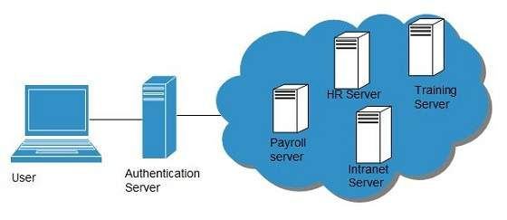
Single Sign-On (SSO)
To solve the problem of using different username and password combinations for different servers, companies now employ Single Sign-On software, which allows the user to login only one time and manage the access to other systems.
SSO has single authentication server, managing multiple accesses to other systems, as shown in the following diagram:
Notes:
Intranet server sends the ticket to the authentication server.
Authentication server sends the user's security credentials for that server back to the intranet server.
If an employee leaves the company, then disabling the user account at the authentication server prohibits the user's access to all the systems.

Slide 97
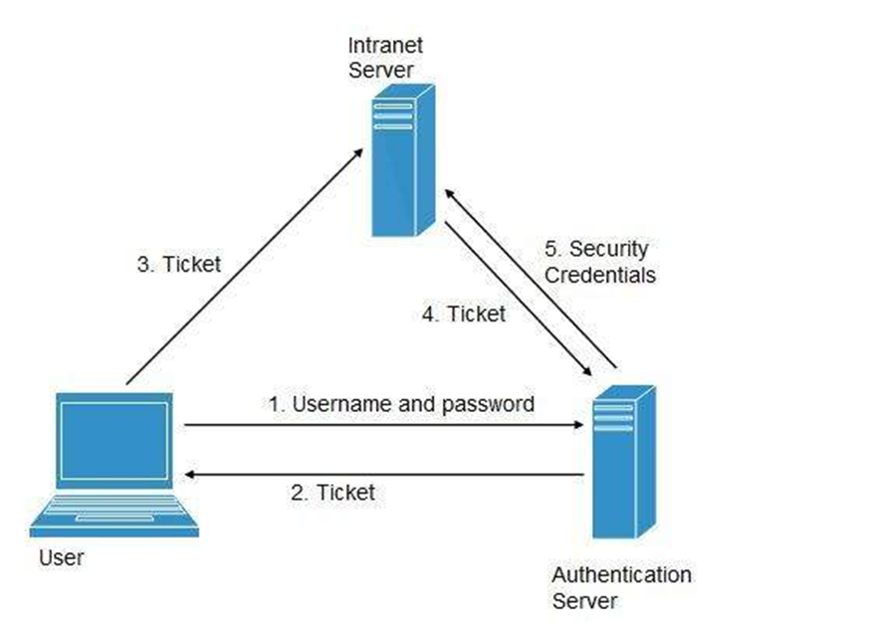
Single Sign-On (SSO)

Slide 98
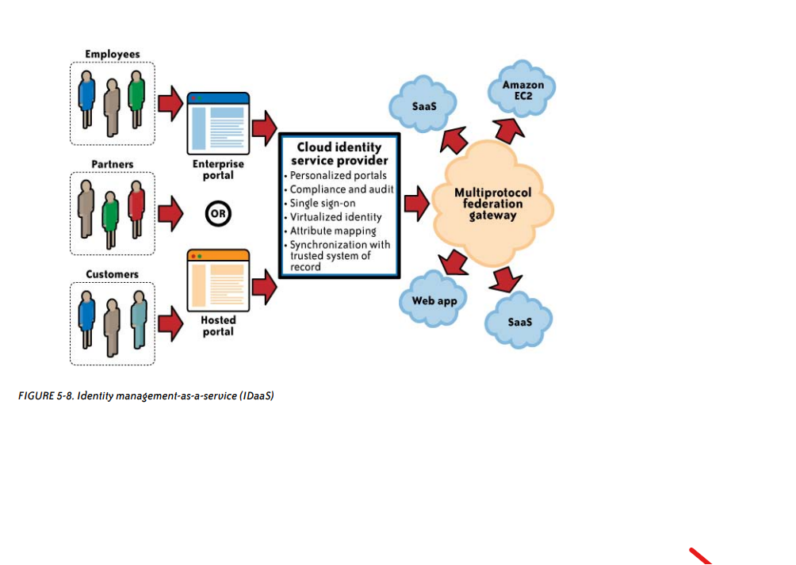
Cloud Authorization Management

